Slide 1
Module-6
Searching Techniques

Slide 2
Linear Search

Slide 3
Sequential Search with Arrays

Slide 4
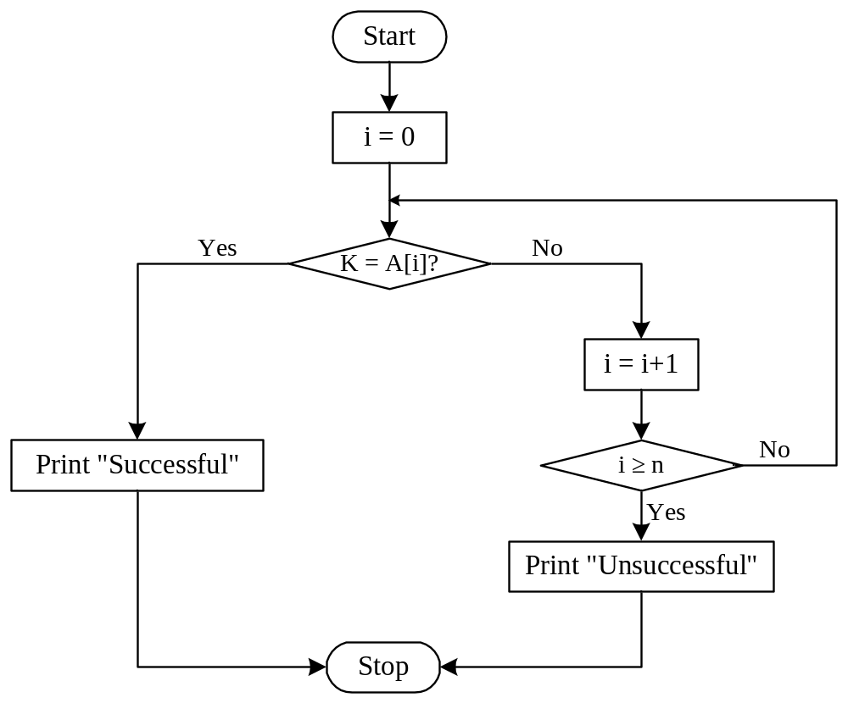
Flowchart: Sequential Search with Array

Slide 5
Example: Sequential Search with Array
int main()
{
int A[10], i, n, K, flag = 0;
printf("Enter the size of an array: ");
scanf("%d",&n);
printf("Enter the elements of the array: ");
for(i=0; i < n; i++)
scanf("%d",&A[i]);
printf("Enter the number to be searched: ");
scanf("%d",&K);
for(i=0;i<n;i++){
if(a[i] == K){
flag = 1; break;
}
}
if(flag == 0)
printf("The number is not in the list");
else
printf("The number is found at index %d",i);
return 0;
}

Slide 6
Binary Search Pseudocode
…
if(size == 0)
found = false;
else {
middle = index of approximate midpoint of array segment;
if(target == a[middle])
target has been found!
else if(target < a[middle])
search for target in area before midpoint;
else
search for target in area after midpoint;
}
…

Slide 7
Binary Search
Perhaps we can do better than O(n) in the average case?
Assume that we are give an array of records that is sorted. For instance:
  an array of records with integer keys sorted from smallest to largest (e.g., ID numbers), or
  an array of records with string keys sorted in alphabetical order (e.g., names).

Slide 8
Binary Search
Example: sorted array of integer keys. Target=7.
[ 0 ]
[ 1 ]
[ 2 ]
[ 3 ]
[ 4 ]
[ 5 ]
[ 6 ]
3
6
7
11
32
33
53

Slide 9
Binary Search
Example: sorted array of integer keys. Target=7.
[ 0 ]
[ 1 ]
[ 2 ]
[ 3 ]
[ 4 ]
[ 5 ]
[ 6 ]
3
6
7
11
32
33
53
Find approximate midpoint

Slide 10
Binary Search
Example: sorted array of integer keys. Target=7.
[ 0 ]
[ 1 ]
[ 2 ]
[ 3 ]
[ 4 ]
[ 5 ]
[ 6 ]
3
6
7
11
32
33
53
Is 7 = midpoint key? NO.

Slide 11
Binary Search
Example: sorted array of integer keys. Target=7.
[ 0 ]
[ 1 ]
[ 2 ]
[ 3 ]
[ 4 ]
[ 5 ]
[ 6 ]
3
6
7
11
32
33
53
Is 7 < midpoint key? YES.

Slide 12
Binary Search
Example: sorted array of integer keys. Target=7.
[ 0 ]
[ 1 ]
[ 2 ]
[ 3 ]
[ 4 ]
[ 5 ]
[ 6 ]
3
6
7
11
32
33
53
Search for the target in the area before midpoint.

Slide 13
Binary Search
Example: sorted array of integer keys. Target=7.
[ 0 ]
[ 1 ]
[ 2 ]
[ 3 ]
[ 4 ]
[ 5 ]
[ 6 ]
3
6
7
11
32
33
53
Find approximate midpoint

Slide 14
Binary Search
Example: sorted array of integer keys. Target=7.
[ 0 ]
[ 1 ]
[ 2 ]
[ 3 ]
[ 4 ]
[ 5 ]
[ 6 ]
3
6
7
11
32
33
53
Target = key of midpoint? NO.

Slide 15
Binary Search
Example: sorted array of integer keys. Target=7.
[ 0 ]
[ 1 ]
[ 2 ]
[ 3 ]
[ 4 ]
[ 5 ]
[ 6 ]
3
6
7
11
32
33
53
Target < key of midpoint? NO.

Slide 16
Binary Search
Example: sorted array of integer keys. Target=7.
[ 0 ]
[ 1 ]
[ 2 ]
[ 3 ]
[ 4 ]
[ 5 ]
[ 6 ]
3
6
7
11
32
33
53
Target > key of midpoint? YES.

Slide 17
Binary Search
Example: sorted array of integer keys. Target=7.
[ 0 ]
[ 1 ]
[ 2 ]
[ 3 ]
[ 4 ]
[ 5 ]
[ 6 ]
3
6
7
11
32
33
53
Search for the target in the area after midpoint.

Slide 18
Binary Search
Example: sorted array of integer keys. Target=7.
[ 0 ]
[ 1 ]
[ 2 ]
[ 3 ]
[ 4 ]
[ 5 ]
[ 6 ]
3
6
7
11
32
33
53
Find approximate midpoint.
Is target = midpoint key? YES.

Slide 19
Binary Search Implementation
void search(const int a[ ], size_t first, size_t size, int target, bool& found, size_t& location)
{
size_t middle;
if(size == 0) found = false;
else {
middle = first + size/2;
if(target == a[middle]){
location = middle;
found = true;
}
else if (target < a[middle])
// target is less than middle, so search subarray before middle
search(a, first, size/2, target, found, location);
else
// target is greater than middle, so search subarray after middle
search(a, middle+1, (size-1)/2, target, found, location);
}
}

